Slide 1
Oracle Financials
GAIA LINKAGE
Toshiba Information Equipment Phils.,Inc.
2023.08.18
Scope of Disclosure | within TIP only
Head of Information Owner Section | TIP

Slide 2
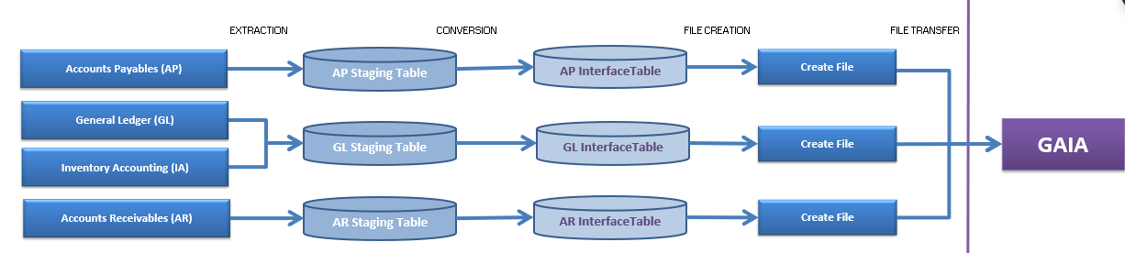
The stages of GAIA Interfacing
Execution timing
AP – Manual Request
AR – Starts at 5pm
GL – Starts at 06:30 am

Slide 3
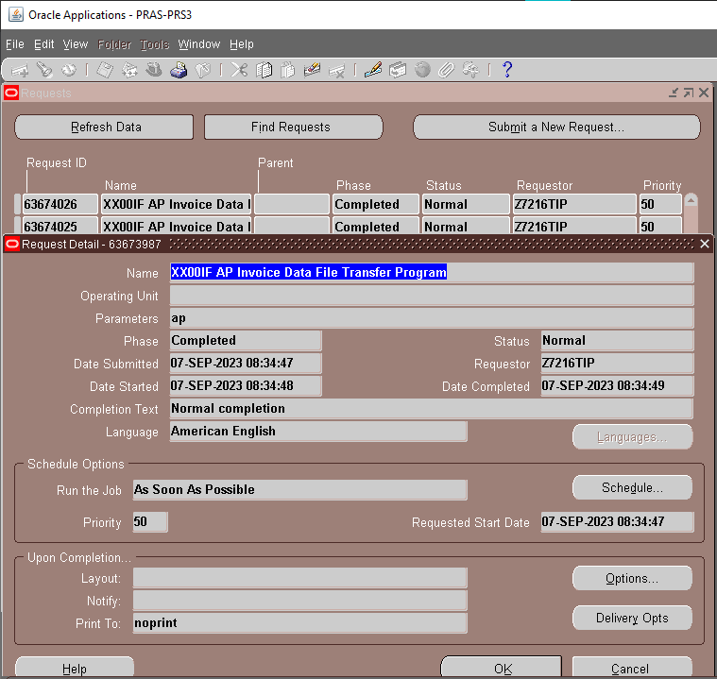
AP DATA FILE TRANSFER SCHEDULE SETUP

Slide 4
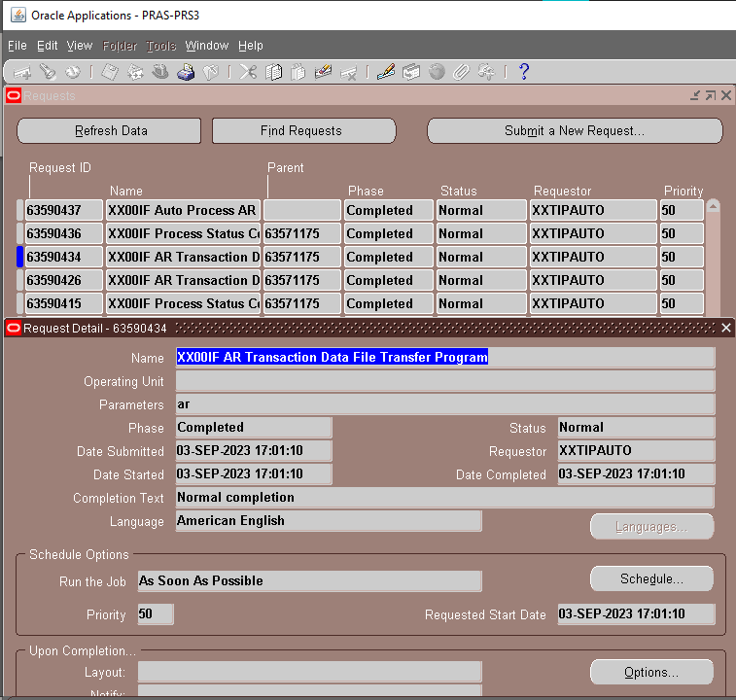
AR DATA FILE TRANSFER SCHEDULE SETUP

Slide 5
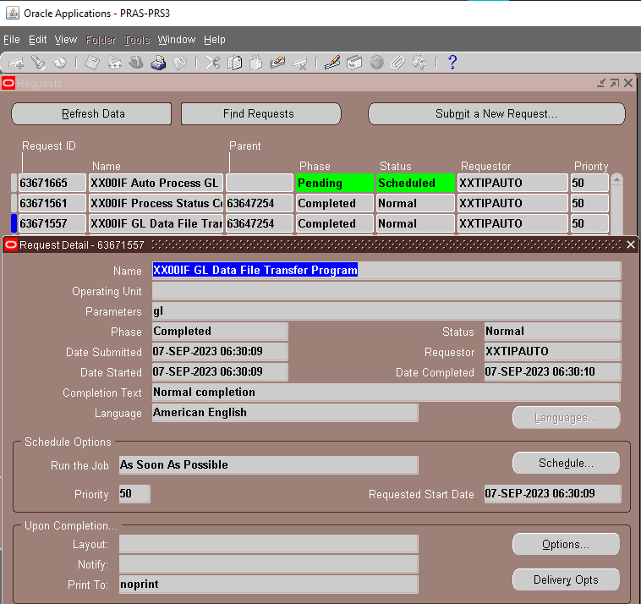
GL DATA FILE TRANSFER SCHEDULE SETUP

Slide 6
PROGRAM
XX00IFCMN_FTP (DATA FILE TRANSFER)

Slide 7
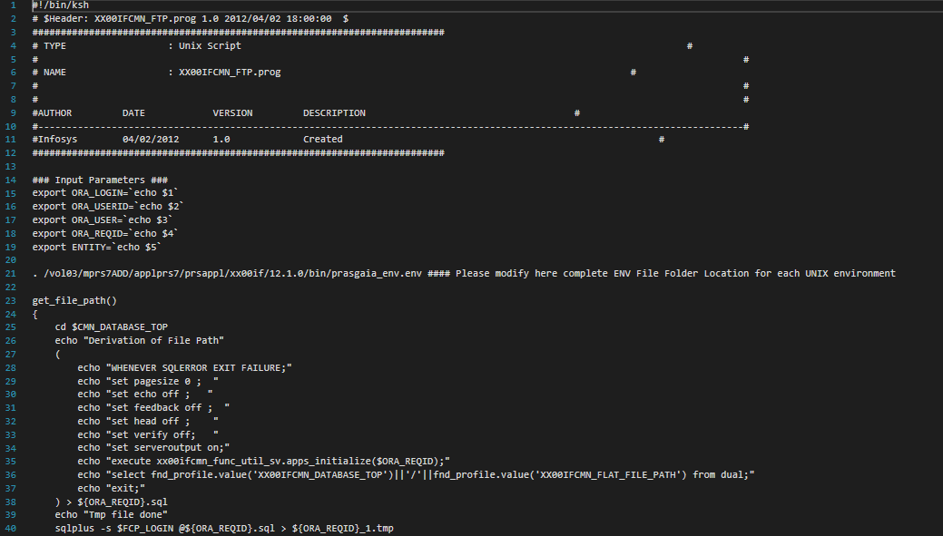

Slide 8
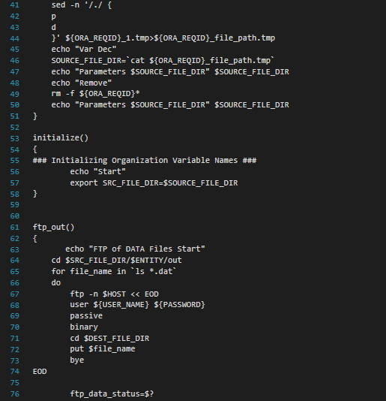

Slide 9
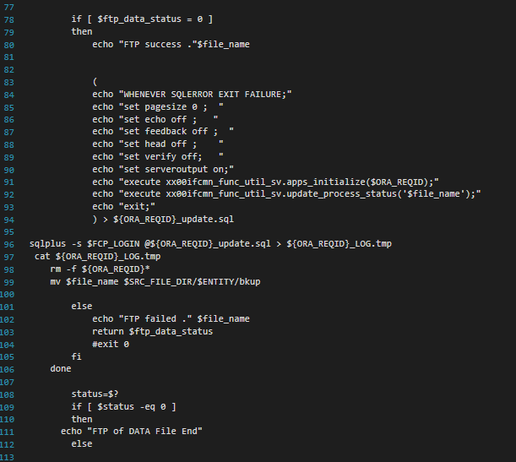

Slide 10
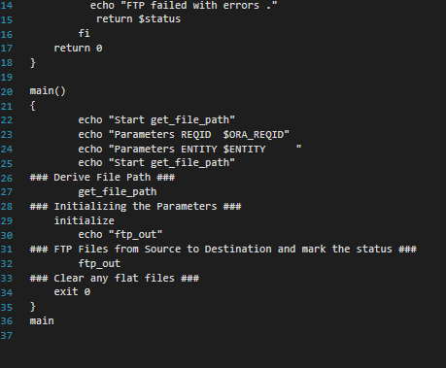

Slide 11
END

